Slide 1
Target Costing
Cost plus pricing is more appropriate when the market demand exceeds the supply.
However when the market competition is increased supply exceed the demand factor of the market and there by price comes down to penetrate the market.
Market is the price setter and company is the price taker.

Slide 2
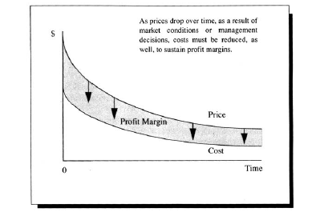
Price/Cost relationship in competitive market

Slide 3
Underlining concept of target costing
“Market price- desired profit margin= Target cost”

Slide 4
Back ward analysis of cost
Current situation Market price 22.00
DM 10.00 Margin (8.00)
DL 7.00 Target cost 14.00
POH 3.00
Cost 20.00
+Margin 40% 8.00
Selling price 28.00

Slide 5
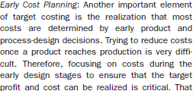
Early cost planning
Chartered Management Accountant USA define ……….

Slide 6
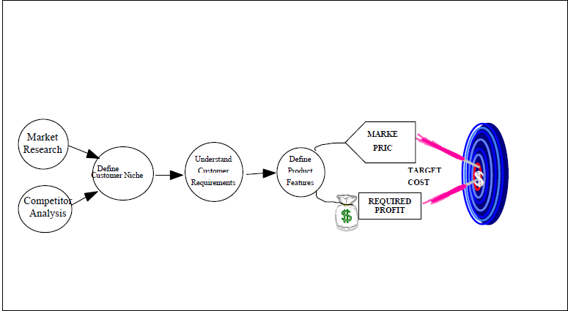
The establishment phase of target costing

Slide 7
How to achieve the target cost
Product innovation
Process innovation
Design innovation
Resources innovation
Value chain analysis

